Slide 1


Solow-Swan model

Slide 2
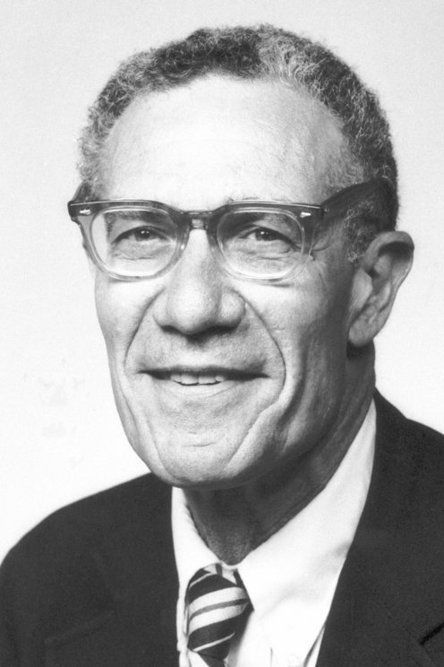
Solow-Swan model
Developed independently by Robert Solow and Trevor Swan in 1956.
Basic model used in the most of more sophisticated economic models.
Helps us understand the factors responsible for development in our company or country.

Slide 3
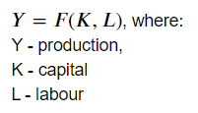
Assumptions
Unlimited demand for goods.
Production is determined by the function of two variables. Y = F(K,L)
Production function exhibits constant-returns-to-scale (CRS).

Slide 4


Cobb-Douglas function
One of the functions used in Solow model.
Production per capita:

Slide 5
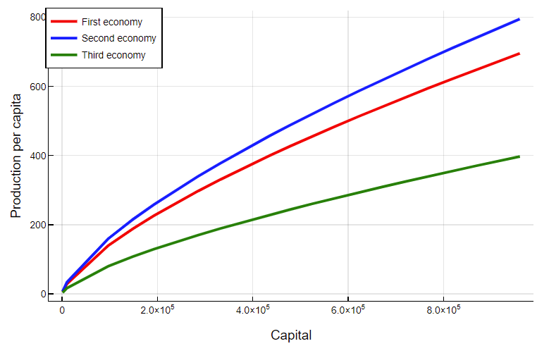

Slide 6
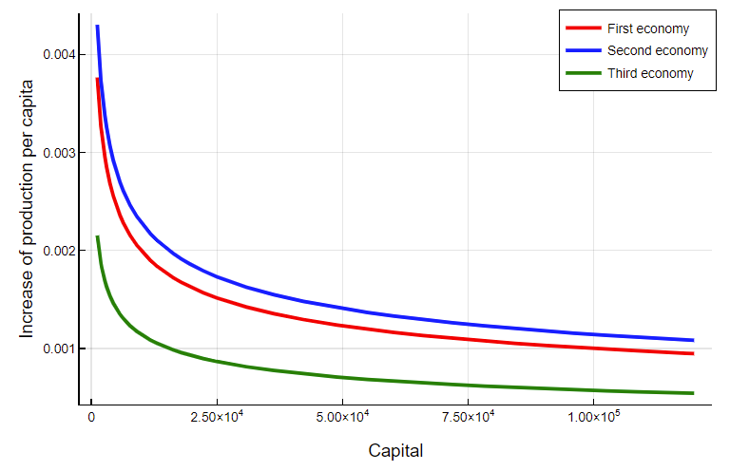

Slide 7
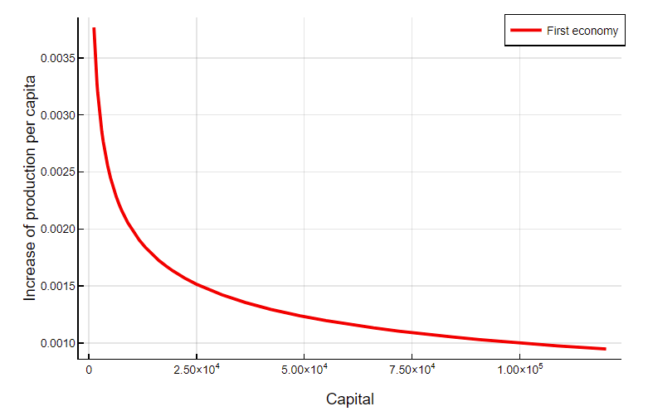

Slide 8


Enhancement of the model
Technological progress should be consulted. It boosts the efficiency of our workers.
Production per capita:

Slide 9
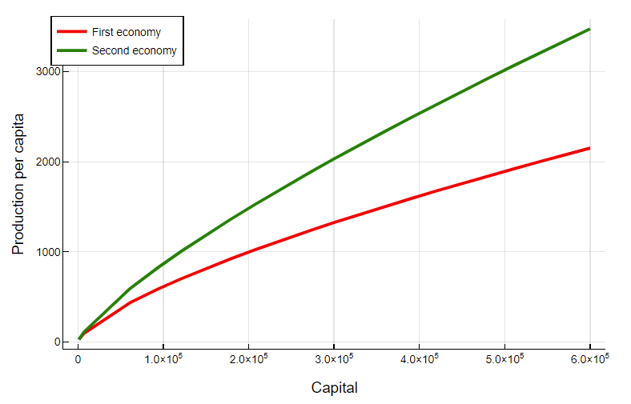

Slide 10

Accumulation of the capital
Production
Savings (sY)
Consumption
𝛿 - depreciation

Slide 11
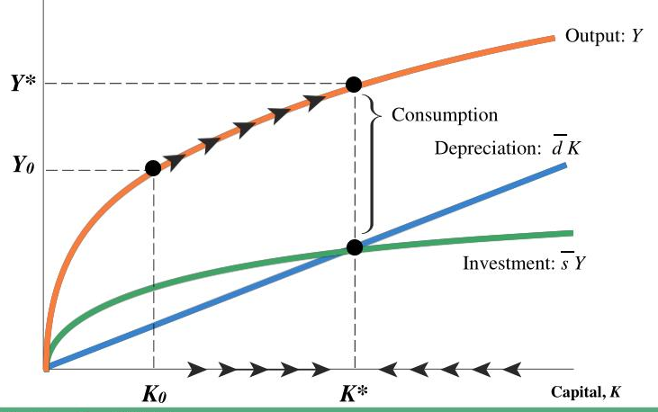
Stable state

Slide 12
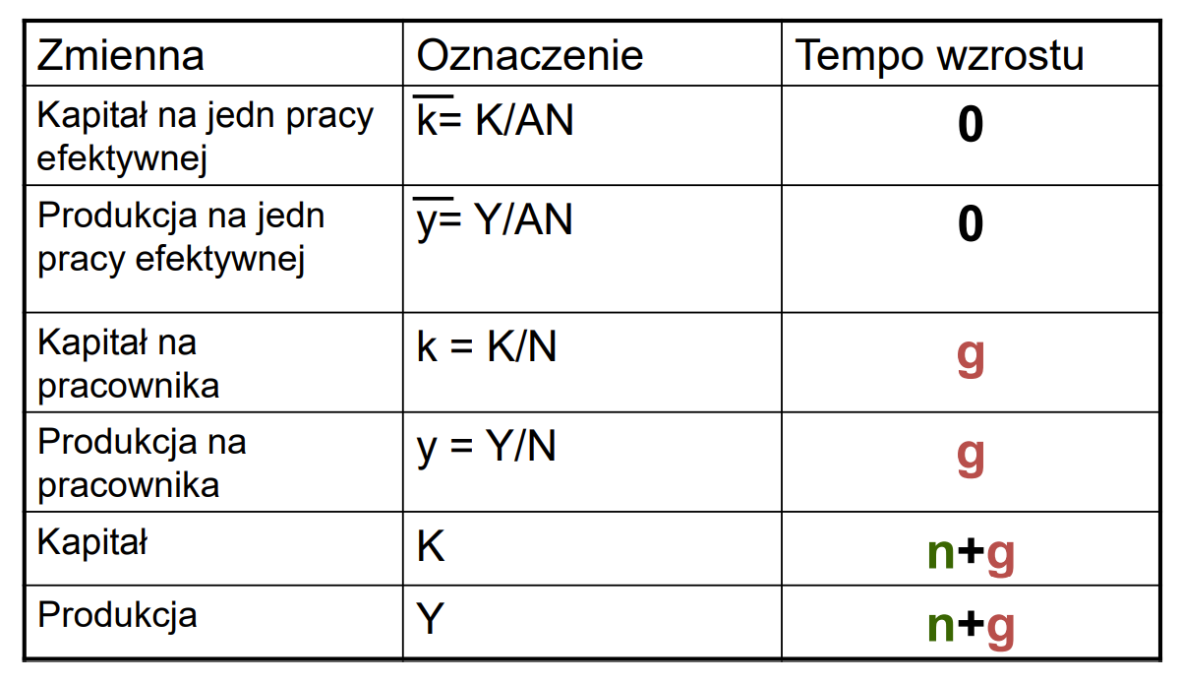

Stable state
Growth rate of production in a stable state equals the change of technological progress.

